Slide 1

Conditional GAN
Ahsan Lodhi, Yang An
Technical University of Munich
Department of Informatics
Computer Vision Group
Garching, 23. July 2019

Slide 2
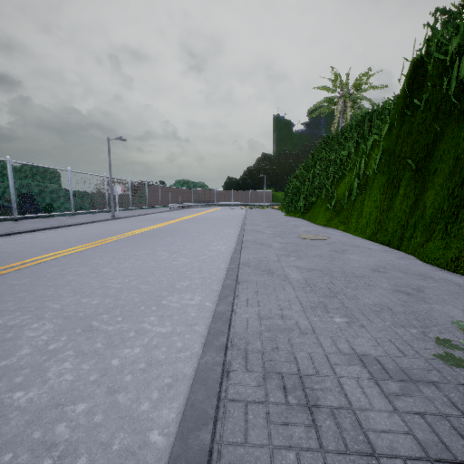
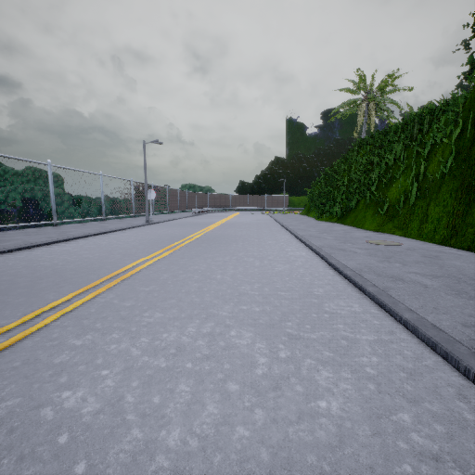
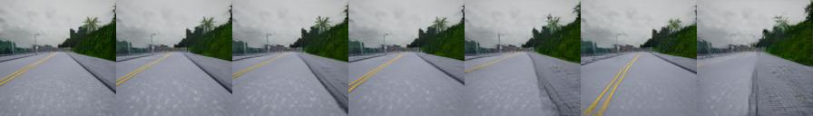
Recap (1/2): Our new architecture
dashed lines are loss
Cycle Loss (L1)
Ground
Truth
L1
Generator
G
Generator
G
Input Image
0m
GAN Loss
Fake Image
2m
GAN Loss
+2.0m
-2.0m
Discriminator D
Discriminator D
relative
target
distance
minus
target
distance

Slide 3
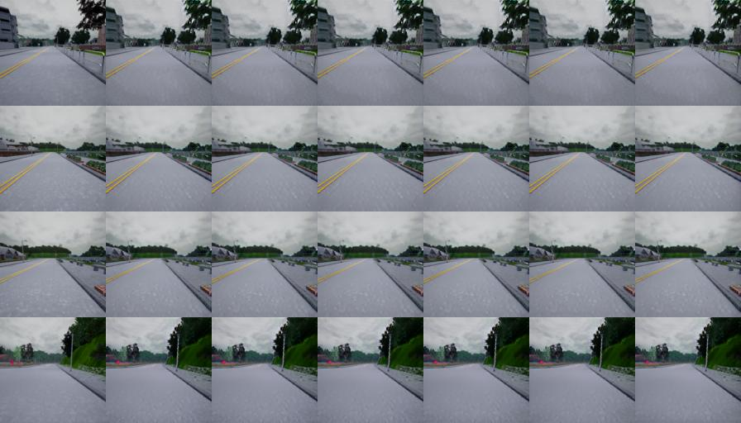
Recap (2/2) Worked quite well
 | Translated Image (Fake Image)
Input Image | Cam 0 0m | Cam 1 0.5m | Cam 2 -0.3m | Cam 3 1.0m | Cam 4 -1.3m | Cam 5 2.0m
Sample 1
Sample 2
Sample 3
Sample 4

Slide 4
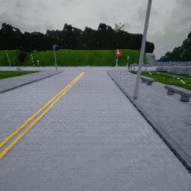
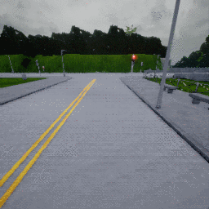
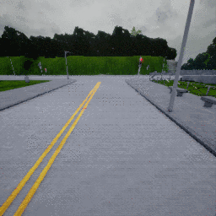
Generate Wibbly Wobbly Data
We used CARLA to generate new images. The car is driving with a randomness of 0.1 and we generated the same six cameras (0, 0.5, -0.3, 1.0, -1.3, 2.0).
Left Camera -0.3
Middle Camera 0
Right Camera 0.5

Slide 5
Change in Training Technique
Trained on first ~90% frames Tested on last ~10% unlike before

Slide 6
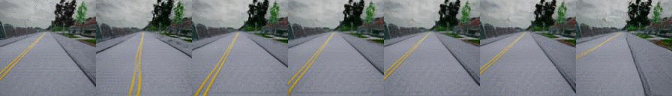
Training results for Middle Camera
Input | Generated
0 | -1.3 | -0.3 | 0 | 0.5 | 1 | 2

Slide 7
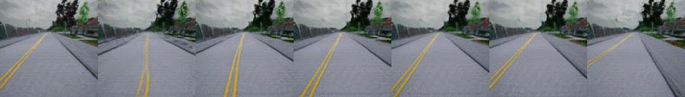
Training results for Left Camera
Input | Generated
-0.3 | -1.6 | -0.6 | -0.3 | 0.2 | 0.7 | 1.7

Slide 8
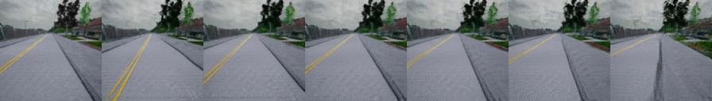
Training results for Right Camera
Input | Generated
0.5 | -0.8 | 0.2 | 0.5 | 1 | 1.5 | 2.5

Slide 9
Training results Middle Camera
Middle to Right
Only seen camera during training
Input | Identity | Distances within Training |  |  |  |  | Distances out of Training Range
0 | 0.0 | +0.4 | +0.8 | +1.2 | +1.6 | +2.0 | +2.2 | +2.4 | +2.8 | +3.0

Slide 10
Training results Middle Camera
Middle to Left
Input | Identity | Distances within Training |  |  | Distances out of Training Range
0 | 0.0 | -0.4 | -0.8 | -1.2 | -1.6 | -2.0 | -2.2 | -2.4 | -2.8 | -3.0

